Slide 1
CS 106A, Lecture 18 Practice with 1D and 2D Arrays

Slide 2




HW5:
ImageShop
We are here
Practice
2D Arrays
Arrays
Midterm!
The River of Java

Slide 3
Plan for Today
Recap: 2D Arrays and Images
Practice: Shrink
Practice: Cryptogram
Practice: Tic-Tac-Toe

Slide 4
Plan for Today
Recap: 2D Arrays and Images
Practice: Shrink
Practice: Cryptogram
Practice: Tic-Tac-Toe

Slide 5

The Matrix
Image used under “fair use” for educational purposes.
Source: https://www.themarysue.com/decoding-the-transgender-matrix-the-matrix-as-a-transgender-coming-out-story/

Slide 6
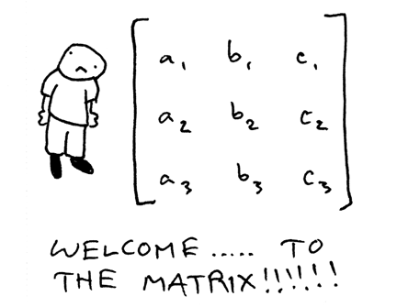
2D Arrays (“Matrices”)

Slide 7
2D Arrays
type[][] name = new type[rows][columns];
int[][] a = new int[3][5];
 | 0 | 1 | 2 | 3 | 4
0 | a[0][0] | a[0][1] | a[0][2] | a[0][3] | a[0][4]
1 | a[1][0] | a[1][1] | a[1][2] | a[1][3] | a[1][4]
2 | a[2][0] | a[2][1] | a[2][2] | a[2][3] | a[2][4]

Slide 8
2D Arrays = Arrays of Arrays!
int[][] a = new int[3][4];
int[] firstRow = a[0];
a[0][0] | a[0][1] | a[0][2] | a[0][3]
a[1][0] | a[1][1] | a[1][2] | a[1][3]
a[2][0] | a[2][1] | a[2][2] | a[2][3]

Slide 9
Summary: 2D Arrays
Make a new 2D array
type[][] name = new type[rows][columns];
Get and set values using bracket notation
name[row][col] // get elem at row,col
name[row][col] = value; // set elem at row,col
Get the number of rows and columns
arr.length // # rows
arr[0].length // # columns
Iterate over a 2D array using a double for-loop
for (int row = 0; row < arr.length; row++) {
for (int col = 0; col < arr[0].length; col++) {
// do something with arr[row][col];
}
}

Slide 10
Limitations of 2D Arrays
Unlike 1D arrays, you cannot compare 2D arrays with Arrays.equals. You must use Arrays.deepEquals.
int[][] a1 = ...
int[][] a2 = ...
if (Arrays.deepEquals(a1, a2)) { ... }
A 2D array does not know how to print itself:
int[][] a = new int[rows][cols];
println(a); // [[I@8cf420
println(Arrays.toString(a)); // [[I@6b3f44,[I@32c2a8]...
// [[0, 1, 2, 3, 4], [1, 2, ...
println(Arrays.deepToString(a));
Notes:
Just like how we can’t do much with chars – but luckily, there are Character methods! Same thing for Arrays.

Slide 11

Images
Images are just grids (2D arrays!) of pixels! Pixels are just integer values from 0-255.

Slide 12
Images as 2D Arrays
We can get a GImage as a 2D array of pixels.
GImage img = new GImage(“res/daisy.jpg”);
int[][] pixels = img.getPixelArray();
int pixel = pixels[0][0]; // top-left pixel
Notes:
How do you modify the pixels?

Slide 13
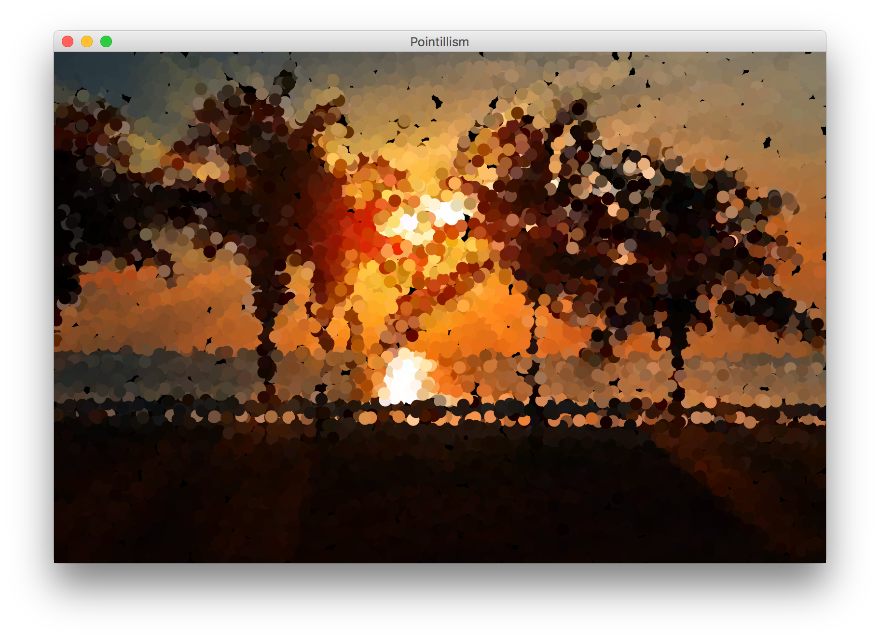

Example: Pointillism
Pointillism is an art style where many small dots of color are combined to make a larger image.

Slide 14
Red, Green and Blue in one int?
Images encode the R, G, and B values of a pixel into a single integer between 0 and 255. You can convert between this pixel value and the individual RGB values.
int[][] pixels = image.getPixelArray();
int px = pixels[0][0];
int red = GImage.getRed(px);
int green = GImage.getGreen(px);
int blue = GImage.getBlue(px);

Slide 15
Creating New Pixels
Images encode the R, G, and B values of a pixel into a single integer between 0 and 255. You can convert between this pixel value and the individual RGB values.
You can also create pixels with your own RGB values.
int r = ...
int g = ...
int b = ...
int pixel = GImage.createRGBPixel(r, g, b);

Slide 16
Images as 2D Arrays
We can get a GImage as a 2D array of pixels, and modify it any way we want. Then, we can create a new GImage with the modified pixels.
GImage img = new GImage(“res/daisy.jpg”);
int[][] pixels = img.getPixelArray();
... (modify pixels)
img.setPixelArray(pixels); // update image
// or make a new GImage
GImage newImg = new GImage(pixels);

Slide 17
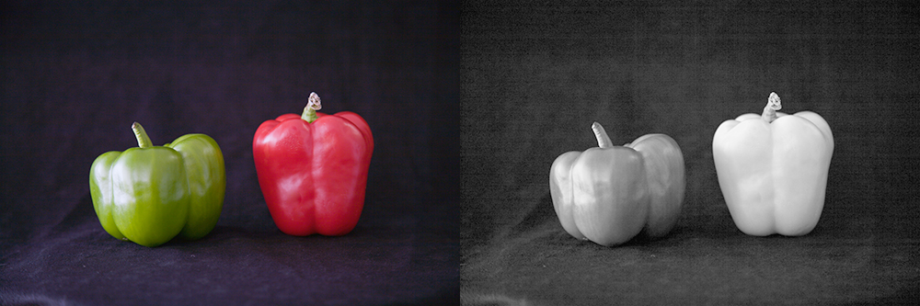
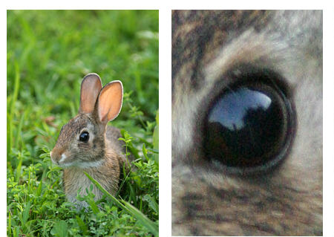
Modifying Image Pixels
There are many cool image algorithms based around modifying individual pixels in an image: grayscale, brighten, normalize, remove red-eye…
grayscale
zoom

Slide 18
GImage Pixel Methods
GImage img = new GImage("res/daisy.jpg");
Method name | Description
img.getPixelArray() | returns pixels as 2D array of ints, where each int in the array contains all 3 of Red, Green, and Blue merged into a single integer
img.setPixelArray(array); | updates pixels using the given 2D array of ints
GImage.createRGBPixel(r, g, b) | returns an int that merges the given amounts of red, green and blue (each 0-255)
GImage.getRed(px) GImage.getGreen(px) GImage.getBlue(px) | returns the redness, greenness, or blueness of the given pixel as an integer from 0-255

Slide 19
Recap: Modifying Pixels
Extract pixel RGB colors with GImage.getRed/Blue/Green.
int red = GImage.getRed(pixels[0][0]); // 0-255
int green = GImage.getGreen(pixels[0][0]); // 0-255
int blue = GImage.getBlue(pixels[0][0]); // 0-255
Modify the color components for a given pixel.
red = 0; // remove redness
Combine the RGB back together into a single int.
pixels[0][0] = GImage.createRGBPixel(red, green, blue);
Update the image with your modified pixels when finished.
image.setPixelArray(pixels);

Slide 20
Plan for Today
Recap: 2D Arrays and Images
Practice: Shrink
Practice: Cryptogram
Practice: Tic-Tac-Toe

Slide 21
Shrink
Let’s write a program that can shrink an image to ½ its original size.

Slide 22
Shrink

Slide 23
Shrink

Slide 24
Shrink
Given a pixel (x, y) in our smaller image, how do we know which pixel in our larger image should go there?

Slide 25
Shrink
Given a pixel (x, y) in our smaller image, how do we know which pixel in our larger image should go there?
(0 , 0) |  | (0, 2)
(2, 0) |  | (2, 2)
(0, 0) | (0, 1)
(1, 0) | (1, 1)

Slide 26
Shrink
Given a pixel (x, y) in our smaller image, how do we know which pixel in our larger image should go there?

Slide 27
Shrink
int[][] pixels = image.getPixelArray();
int[][] result =
new int[pixels.length/2][pixels[0].length/2];
for (int r = 0; r < result.length; r++) {
for (int c = 0; c < result[0].length; c++) { result[r][c] = pixels[r*2][c*2];
}
}
image.setPixelArray(result);

Slide 28
Shrink
int[][] pixels = image.getPixelArray();
int[][] result =
new int[pixels.length/2][pixels[0].length/2];
for (int r = 0; r < result.length; r++) {
for (int c = 0; c < result[0].length; c++) { result[r][c] = pixels[r*2][c*2];
}
}
image.setPixelArray(result);

Slide 29
Shrink
int[][] pixels = image.getPixelArray();
int[][] result =
new int[pixels.length/2][pixels[0].length/2];
for (int r = 0; r < result.length; r++) {
for (int c = 0; c < result[0].length; c++) { result[r][c] = pixels[r*2][c*2];
}
}
image.setPixelArray(result);

Slide 30
Shrink
int[][] pixels = image.getPixelArray();
int[][] result =
new int[pixels.length/2][pixels[0].length/2];
for (int r = 0; r < result.length; r++) {
for (int c = 0; c < result[0].length; c++) { result[r][c] = pixels[r*2][c*2];
}
}
image.setPixelArray(result);

Slide 31
Shrink
int[][] pixels = image.getPixelArray();
int[][] result =
new int[pixels.length/2][pixels[0].length/2];
for (int r = 0; r < result.length; r++) {
for (int c = 0; c < result[0].length; c++) { result[r][c] = pixels[r*2][c*2];
}
}
image.setPixelArray(result);

Slide 32
Shrink
int[][] pixels = image.getPixelArray();
int[][] result =
new int[pixels.length/2][pixels[0].length/2];
for (int r = 0; r < result.length; r++) {
for (int c = 0; c < result[0].length; c++) { result[r][c] = pixels[r*2][c*2];
}
}
image.setPixelArray(result);

Slide 33
Plan for Today
Recap: 2D Arrays and Images
Practice: Shrink
Practice: Cryptogram
Practice: Tic-Tac-Toe

Slide 34
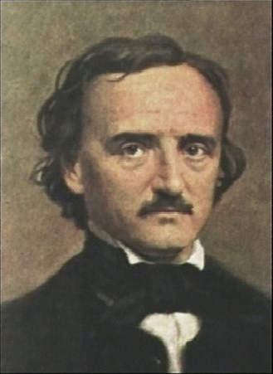
Cryptogram
A cryptogram is a puzzle in which a message is encoded by replacing each letter in the original text with some other letter. Your job in solving a cryptogram is figuring out this substitution pattern.
A common technique is assuming the most common letters in the coded message correspond to the most common letters in English.
Edgar Allan Poe (1809-1849)
Notes:
One of the most famous cryptograms was written by Edgar Allan Poe in his short story “The Gold Bug.”

Slide 35
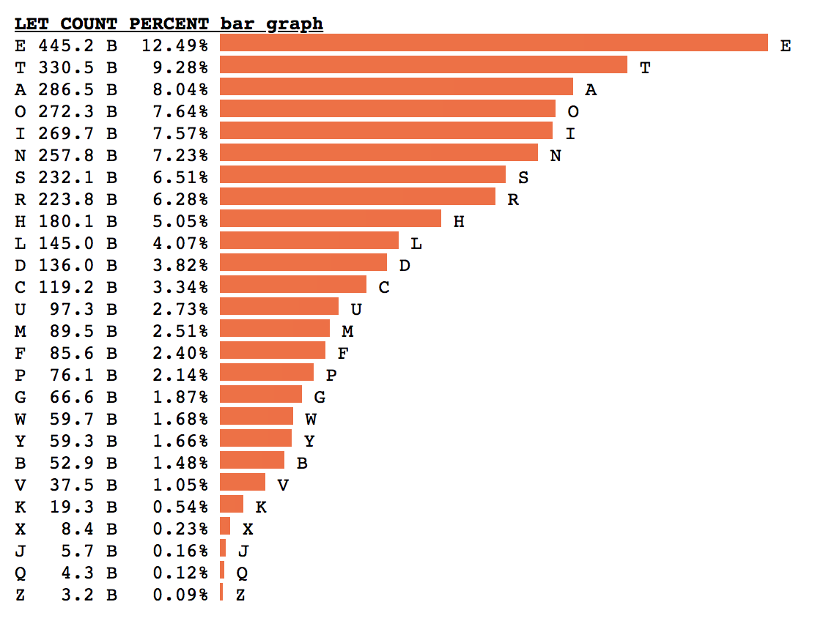
Letter Frequency
By Peter Norvig
Head of Google Research
Former CS221 Instructor
Based on 3.8 trillion letters
Notes:
How does an array help us?

Slide 36
Idea: Array of Counters
For problems like this, where we want to keep count of many things, a frequency table (or tally array) can be a clever solution.
Idea: The element at index i will store a counter for the character value ‘A’ + i.
example: count of letter frequency for ”FIDDLE”
index | … | 3 | 4 | 5 | 6 | 7 | 8 | 9 | 10 | 11 | …
value |  | 2 | 1 | 1 | 0 | 0 | 1 | 0 | 0 | 1

Slide 37
Plan for Today
Recap: 2D Arrays and Images
Practice: Shrink
Practice: Cryptogram
Practice: Tic-Tac-Toe

Slide 38
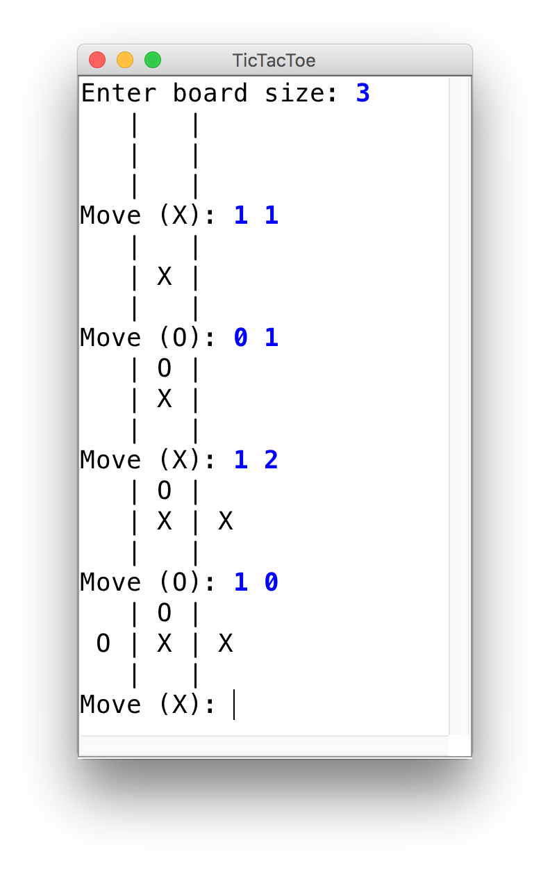
Tic-Tac-Toe
Let’s use 2D arrays to create a ConsoleProgram version of Tic-Tac-Toe.

Slide 39
Recap
Recap: 2D Arrays and Images
Practice: Shrink
Practice: Cryptogram
Practice: Tic-Tac-Toe
Next Time: More data structures

